Slide 1
Analyzing Flow in the Wake of a Taylor Bubble
NE 577 Student

Slide 2
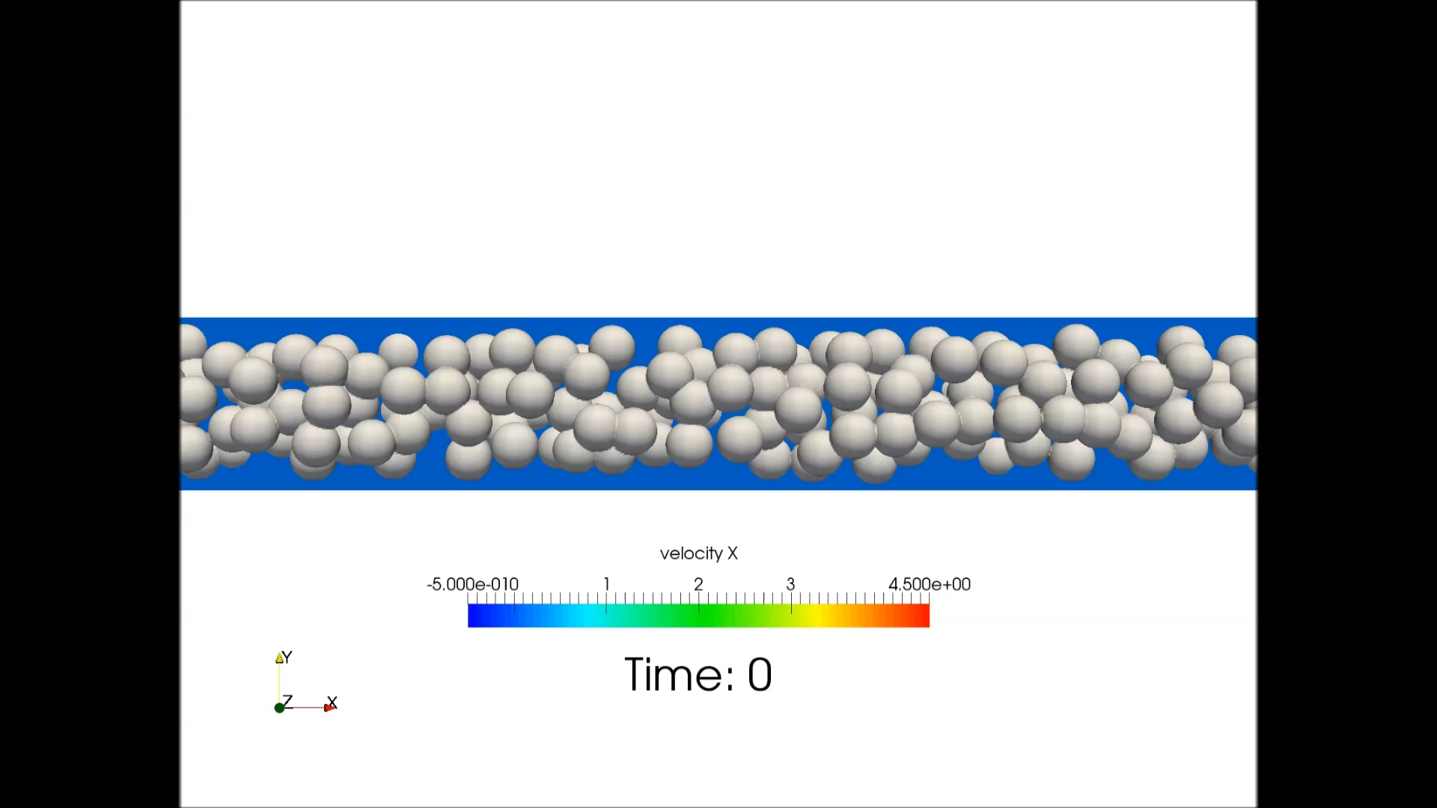
Background
Zimmer, M.D. Ongoing Research. (2017)
Notes:
Highlight Taylor Bubble, Wake

Slide 3
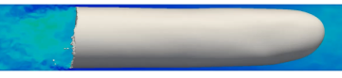
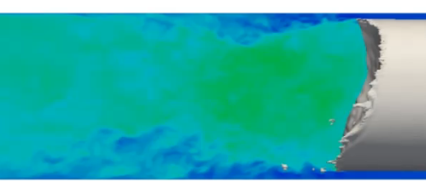
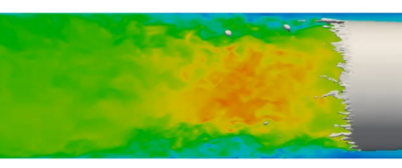
Looking at the wake
Zimmer, M.D. Ongoing Research. (2017)
Notes:
“Model this region”

Slide 4
Progress Overview
Conceive geometry
Iterate, refine
Run Single Phase
Run Two-Phase
Conceive new conditions
Observe Patterns
Observe constraints
Design virtual experiments
Run virtual Experiments

Slide 5


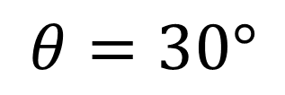
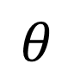
Challenge 1) Large overall domain size
Resolved by using a low initial mesh resolution and cutting the domain into a 30$°$ section
$$θ$$
$$θ=30°$$

Slide 6
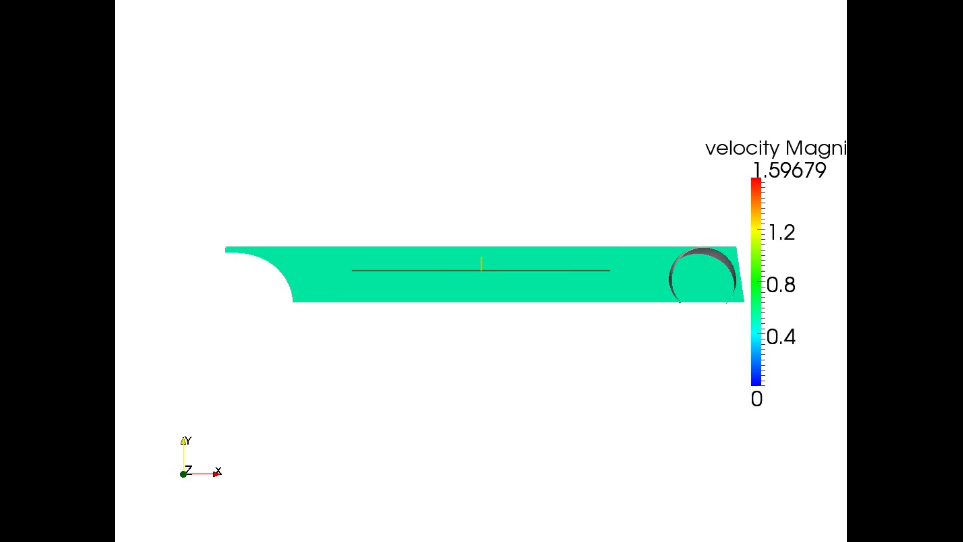

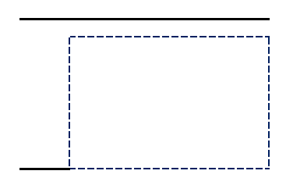
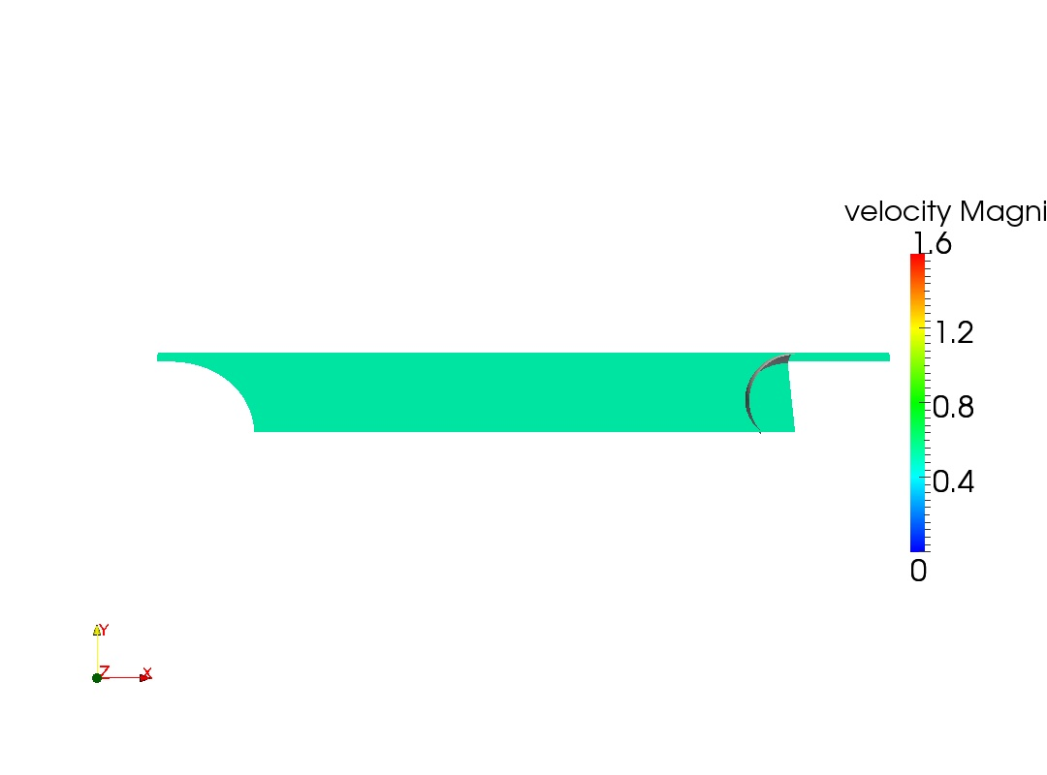
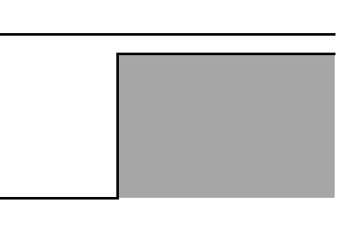
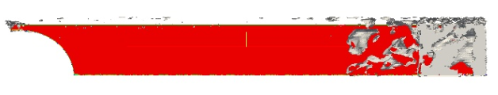
Challenge 2) Lack of convergence with proper Taylor bubble
Resolution
Bubble in a ‘box’ outside expected liquid domain
30 Timesteps
Bubble partially inside expected liquid domain

Slide 7

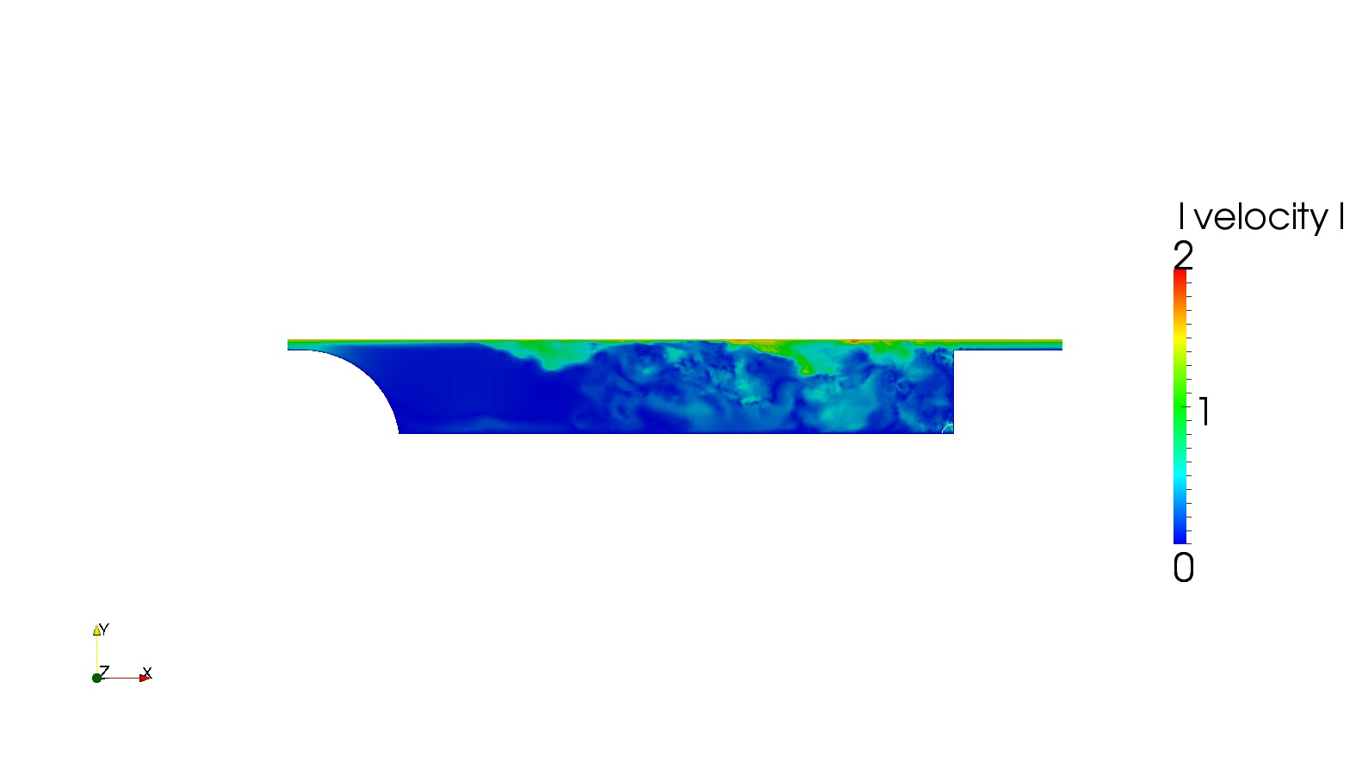
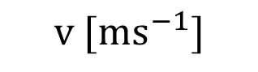
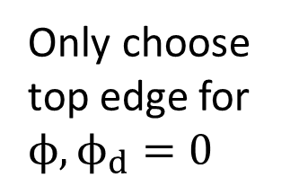
Challenge 3) Bubble leaving the domain
Resolution
5000 Timesteps
$$v [ms^{−1}]$$
Only choose top edge for $ϕ, ϕ_{d}=0$

Slide 8

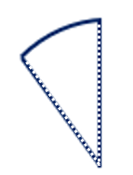
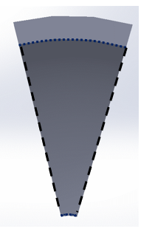
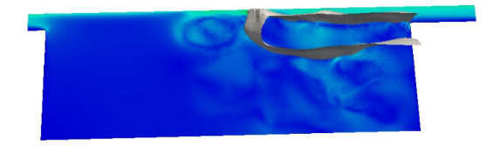
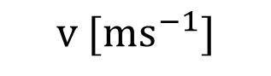
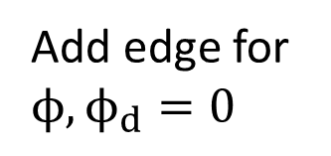
Challenge 4) Holding the bubble to the wall
Resolution
2000 Timesteps
$$v [ms^{−1}]$$
Add edge for $ϕ, ϕ_{d}=0$

Slide 9
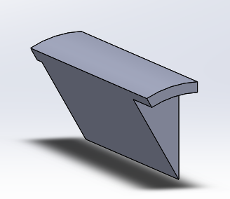
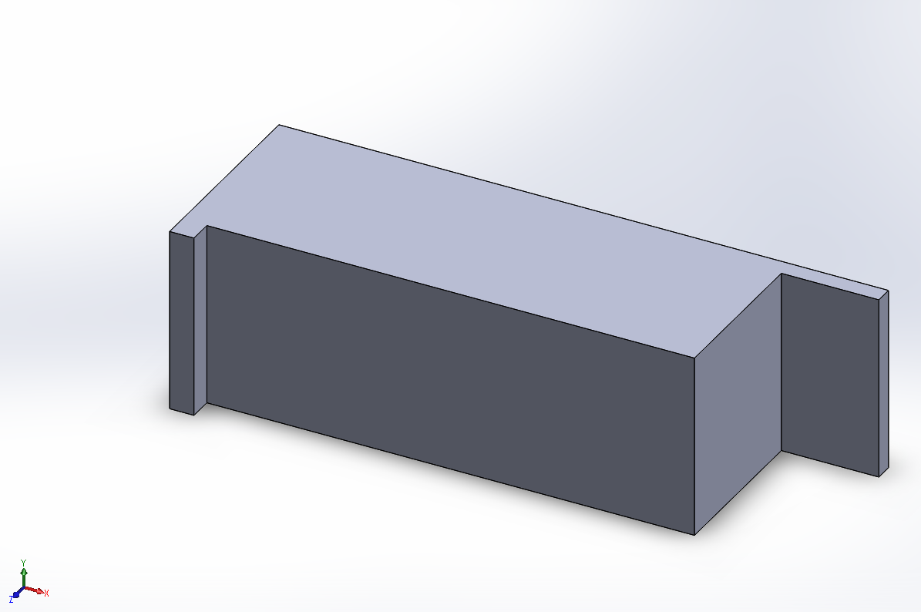
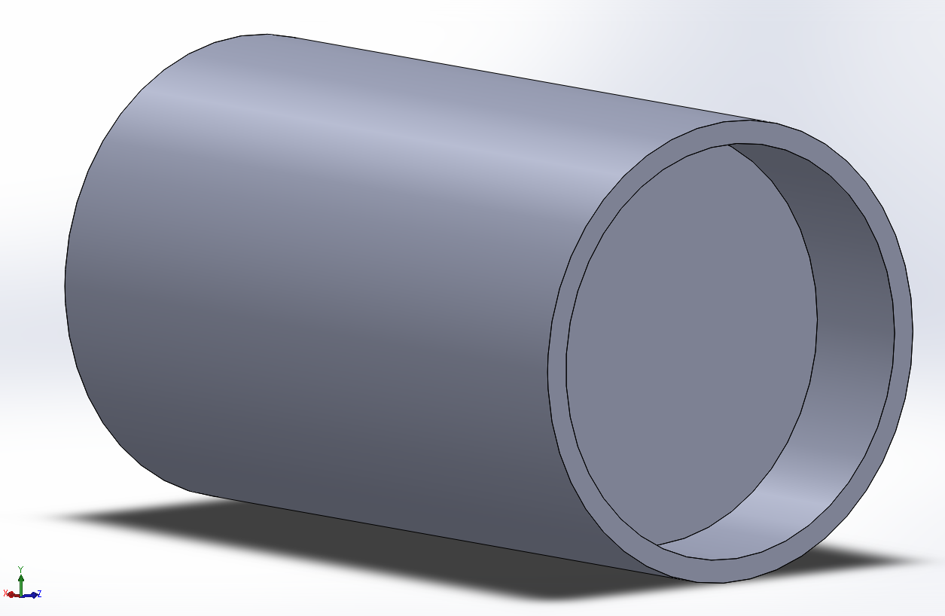
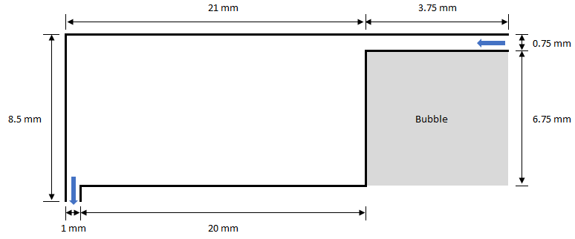
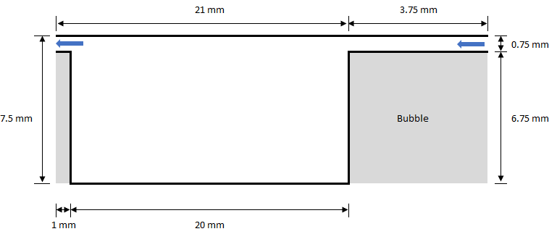
Pipe Geometry Iterations

Slide 10
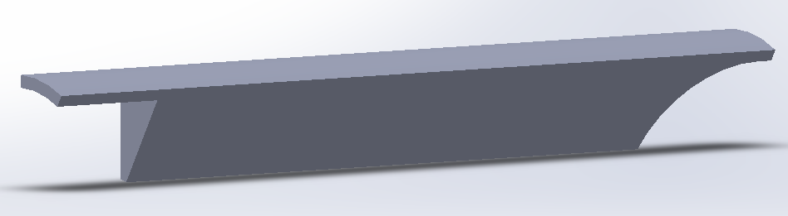
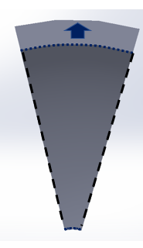
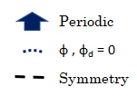
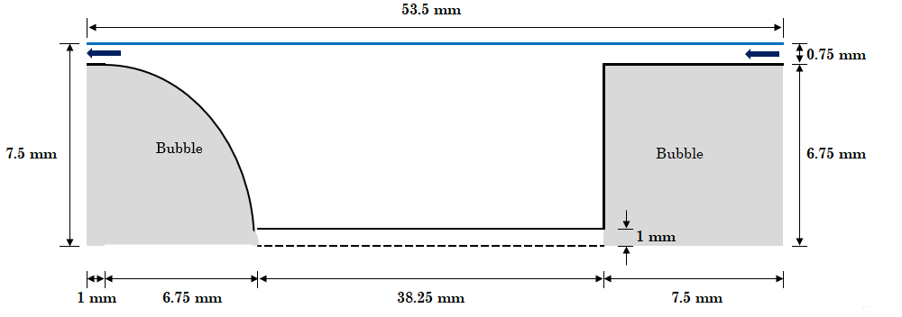
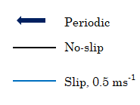
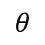

Pipe Dimensions & Boundary Conditions
$$θ$$
$$θ=30°$$
NOT TO SCALE

Slide 11
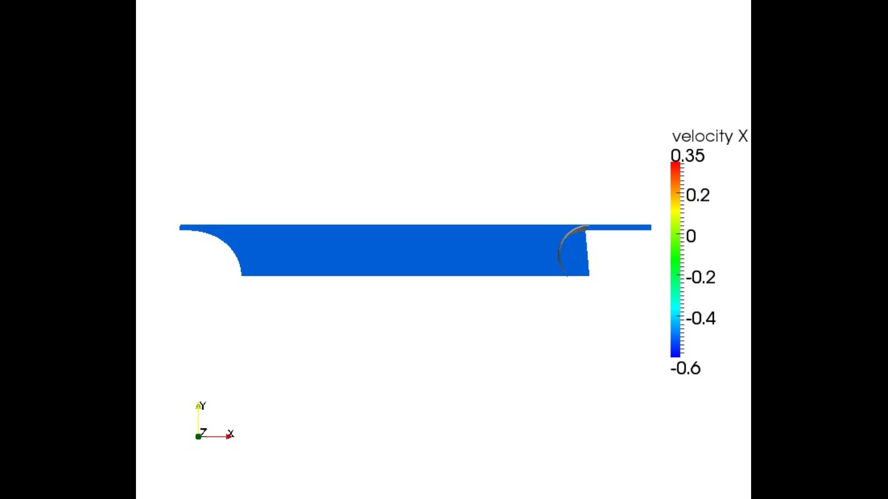
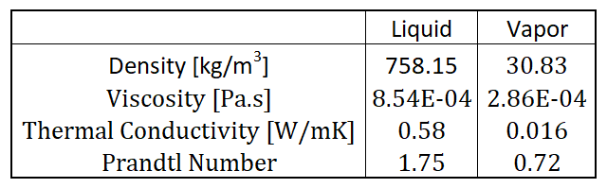
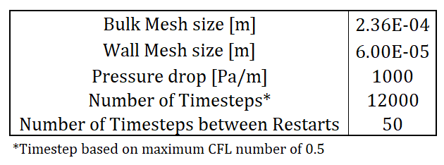
Results (Base Mesh)

Slide 12
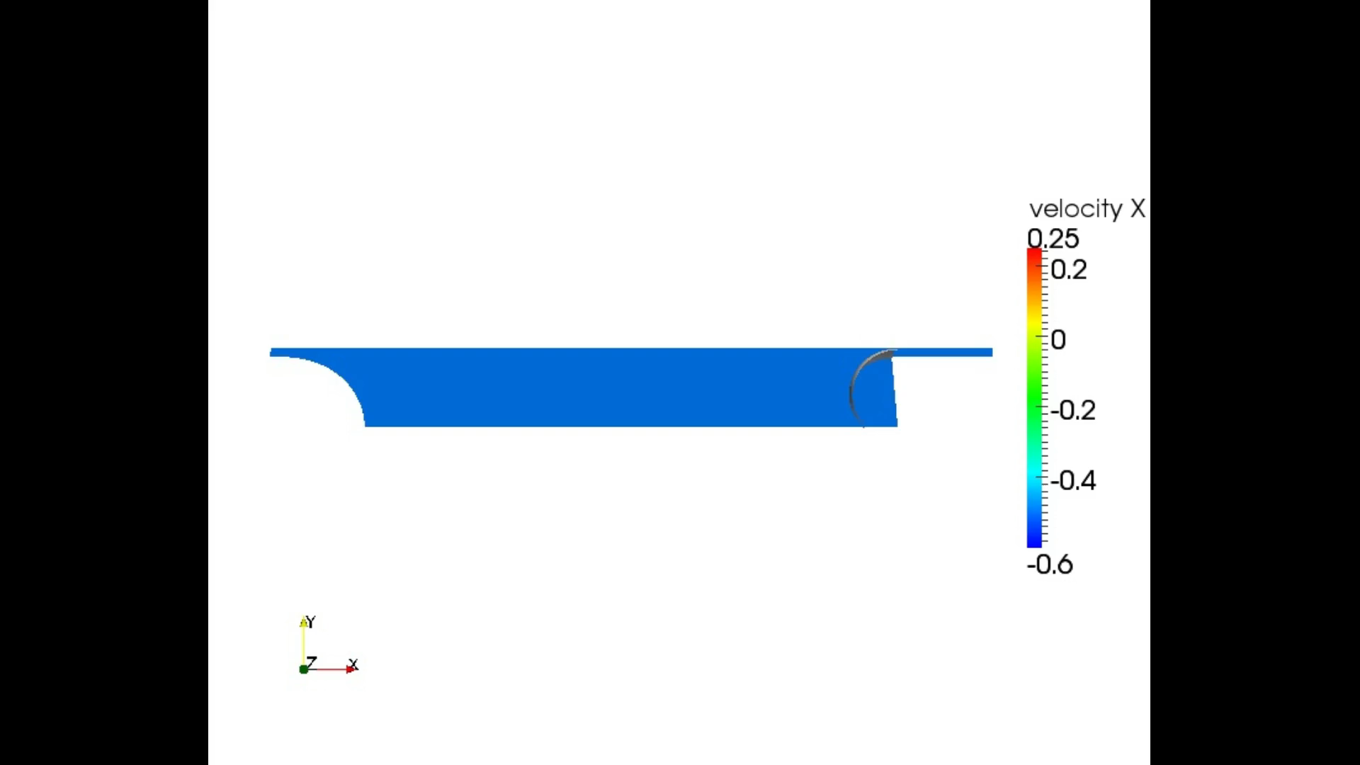
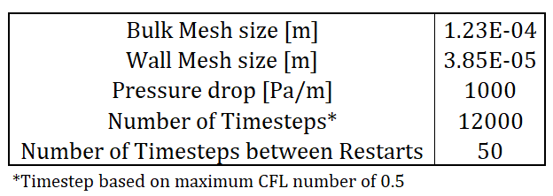
Results (Refined Mesh)

Slide 13
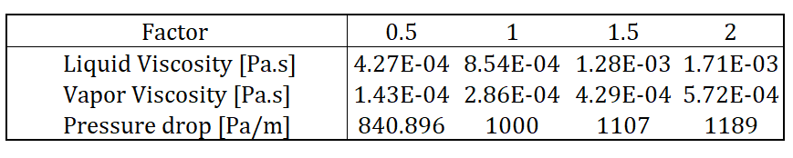
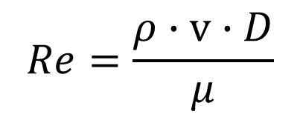
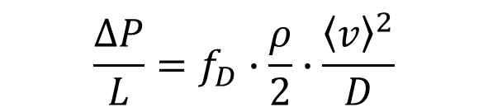
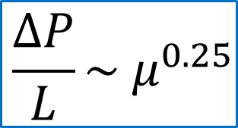
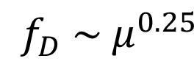
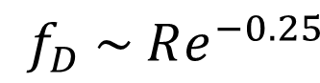

Range of Variables
$$\frac{ΔP}{L}=f_{D}∙\frac{ρ}{2}∙\frac{{\left\langle v\right\rangle }^{2}}{D}$$
$$f_{D} \sim μ^{0.25}$$
$$\frac{ΔP}{L}\sim μ^{0.25}$$
$$f_{D} \sim Re^{−0.25}$$
$$\frac{ΔP}{L}\sim f_{D}$$
$$Re=\frac{ρ∙v∙D}{μ}$$
Bird, R. B., Stewart, W. E., & Lightfoot, E. N. (1965). Transport Phenomena. John Wiley & Sons; 3rd Revised edition

Slide 14
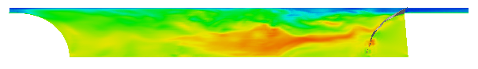
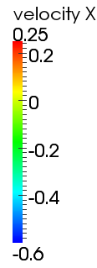
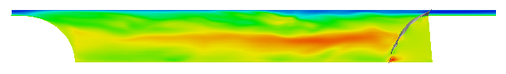
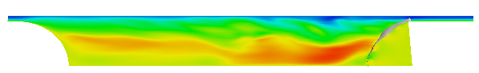
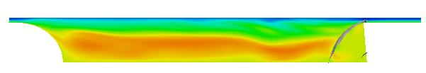
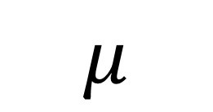


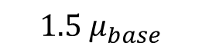

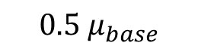
Results (Base Mesh [0.236 mm])
$$0.5 μ_{base}$$
$$μ_{base}$$
$$μ$$
$$1.5 μ_{base}$$
$$2 μ_{base}$$
$$[ms^{−1}]$$

Slide 15
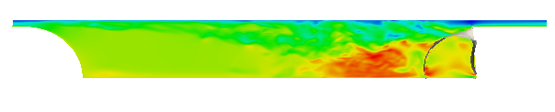





Results (Refined Mesh [0.123 mm]))
$$0.5 μ_{base}$$
$$μ_{base}$$
$$μ$$
$$1.5 μ_{base}$$
$$2 μ_{base}$$
$$[ms^{−1}]$$

Slide 16
Interpretation
Drastic changes observed with increased mesh resolution
Shorter wake lengths across the simulations
In both cases, increasing viscosity increases the apparent wake length
But with increasing viscosity, the wake contains lower mean velocities, and a lower maximum velocity
At the higher resolution, the bubble’s shape changes at increase viscosity
Grounds for further investigation

Slide 17

Learning Outcomes
Learned the basics of running PHASTA
Also learned how to use SolidWorks and ParaView
Learned that $ϕ, ϕ_{d}=0$ can be applied as edge conditions in SimModeler, which is correctly interpreted by PHASTA
Applying it as a condition on a plane doesn’t work so well
Applying it to adjoining edges results in departure from domain
Gained an appreciation for how expensive these two-phase simulations are, and how quickly the cost escalates.
Emphasizes the significance of performing smaller scale studies such as this, making it a worthwhile field of research

Slide 18

Outstanding Problems
Bubble shape is inaccurate
Does not represent Taylor bubble properly
Results in a different type of wake
Drastically changes shape with changing viscosity
Mesh size is still probably too small to consider flow to be ‘fully resolved’
Will need to apply further refinements, perhaps in subdomains around the bubble
Conditions are slower than that of original simulation
Top wall should move at -$1.61$ $ms^{−1}$, bottom wall at +$0.23 ms^{−1}$

Slide 19
Questions?

Slide 20

Challenges Overview
Large overall domain size
Resolved by using a low initial mesh resolution and cutting the domain into a 30$°$ section
Lack of convergence with proper Taylor bubble
Resolved by initializing an approximation bubble within the main domain
Bubble leaving the domain
Resolved by only choosing one edge for the condition $ϕ, ϕ_{d}=0$ (rather than three)
Holding the bubble to the wall
Resolved by chopping off a millimeter from the bottom and adding an extra edge boundary condition with $ϕ, ϕ_{d}=0$

